Slide 1
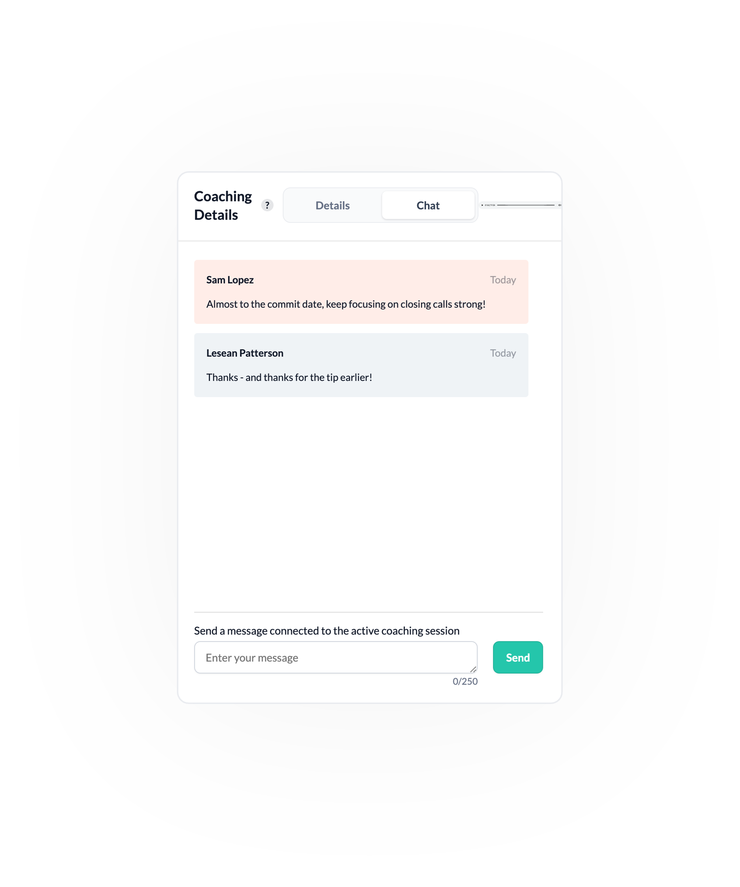
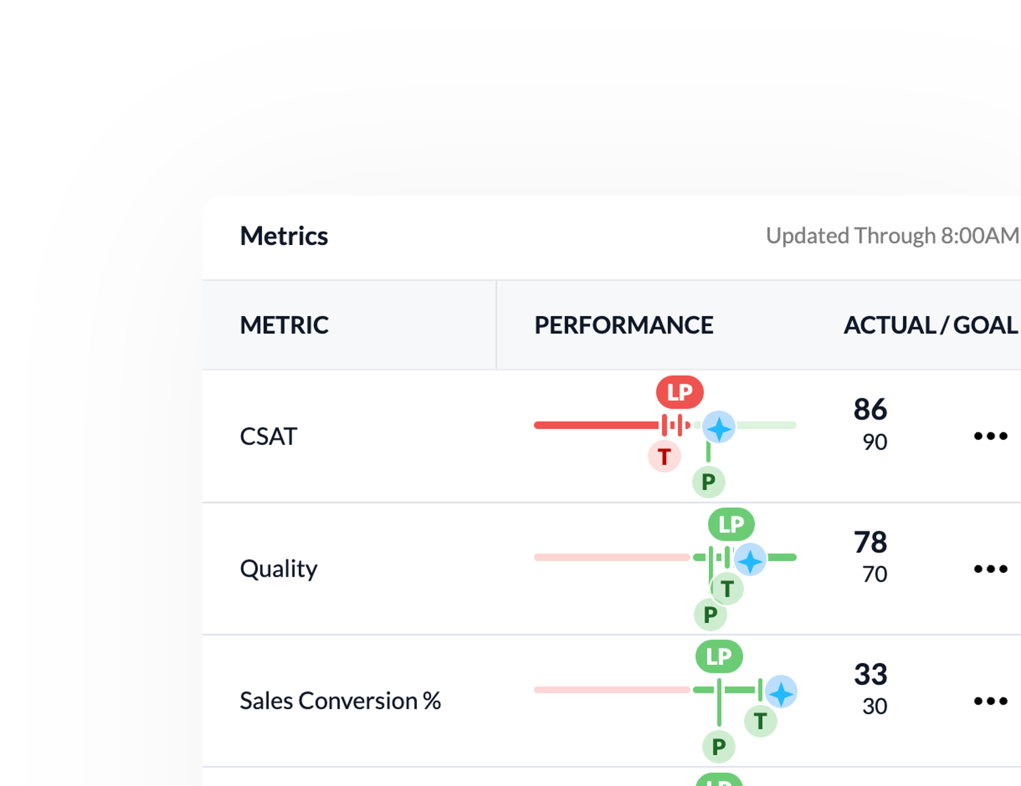
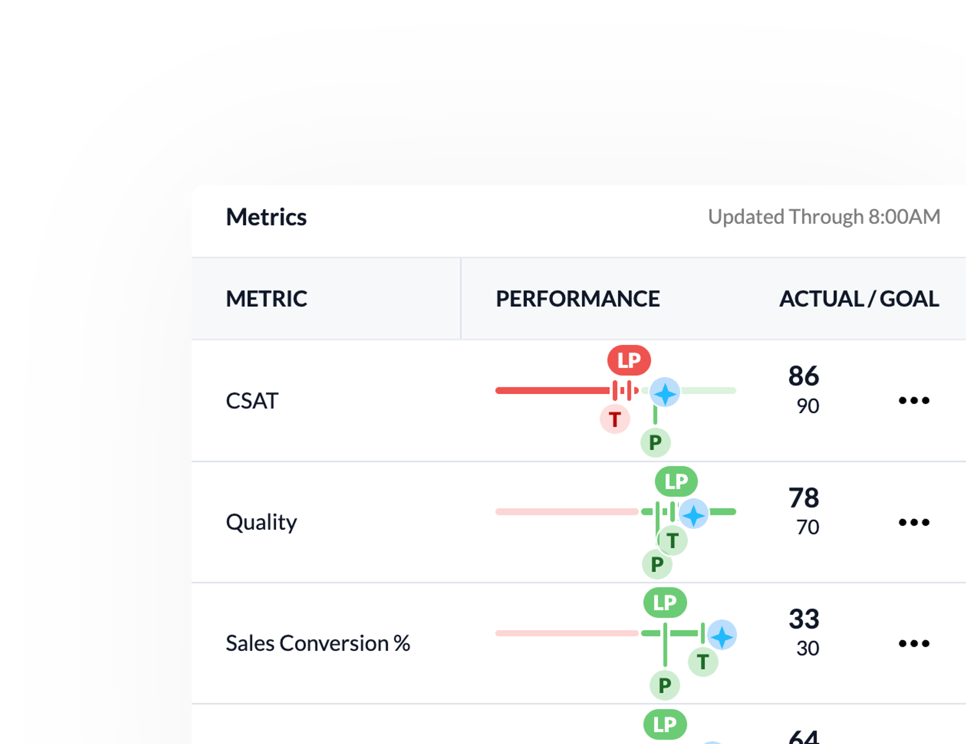
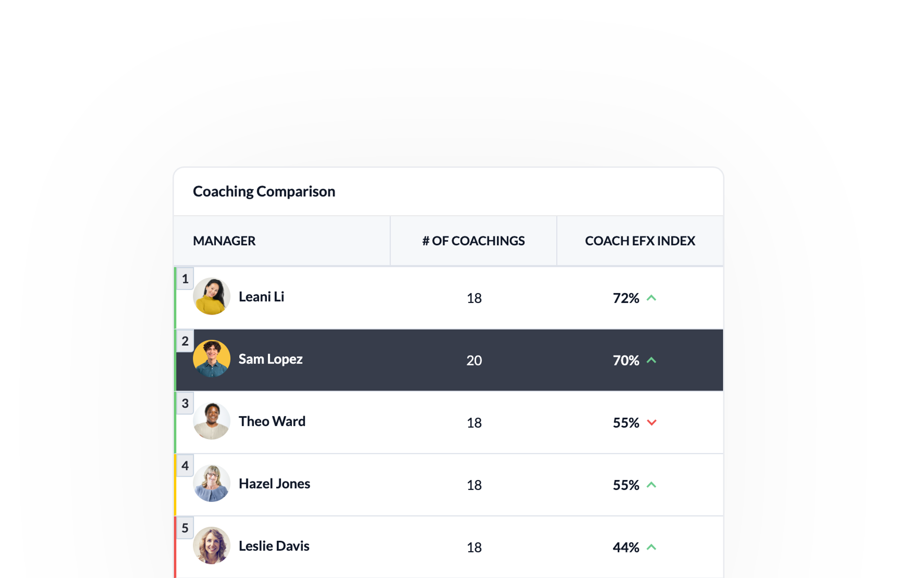
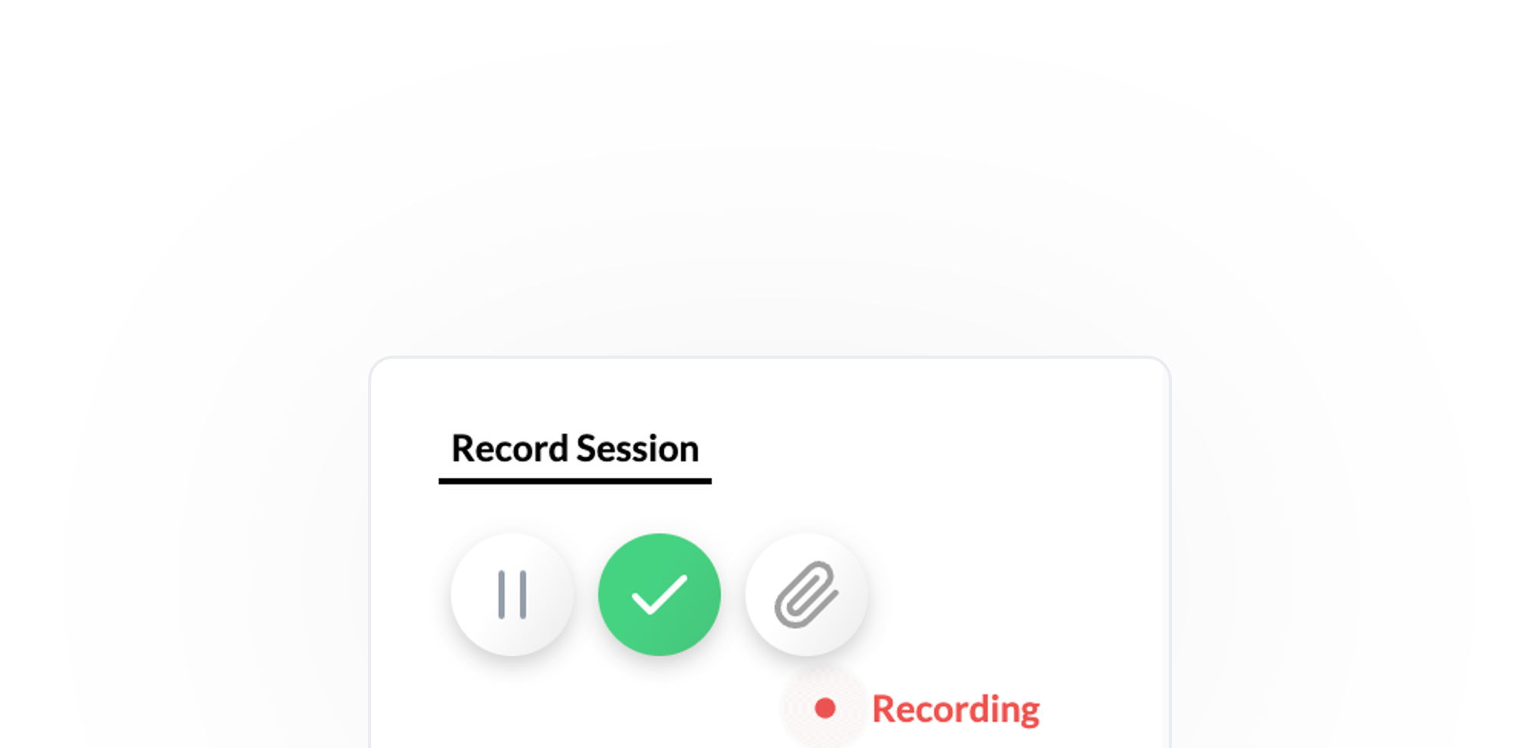
An overview of AI powered contact center transformation

Slide 2
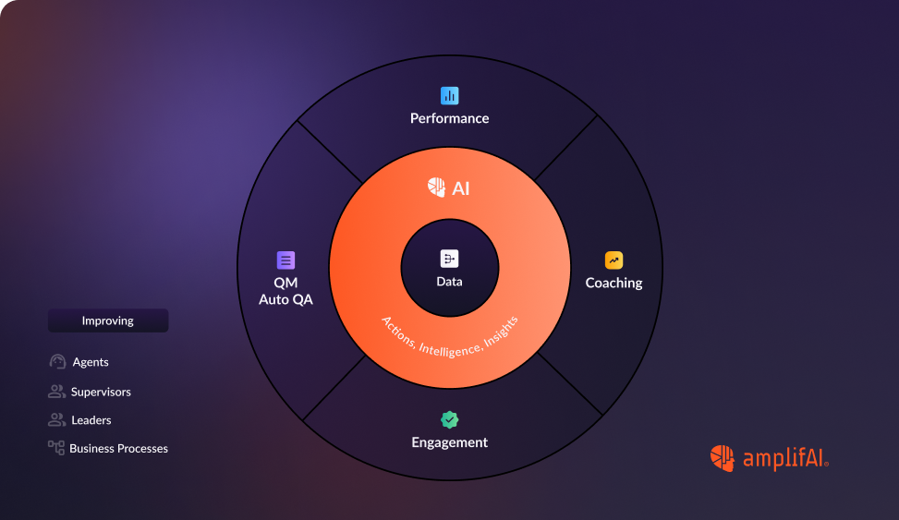
AI-powered contact center transformation addresses this challenge by harnessing the power of artificial intelligence to:
Unify and analyze performance data
Identify high performers and extract insights
Deliver AI driven coaching, engagement and QA
Measure effectiveness, improve key metrics and drive business outcomes
AI-Powered Contact Center Transformation signifies a fundamental shift in how contact centers operate.
AmplifAI leverages the power of artificial intelligence to overcome the challenges posed by information overload, complex CX, and inconsistent performance management, thereby driving substantial improvements in frontline productivity, engagement, and overall effectiveness for all contact center roles.
Modern contact centers are inundated with data from disparate systems like CRM, ticketing tools, quality assurance platforms, and workforce management solutions.
This overwhelming influx of information makes it difficult for frontline associates and managers to identify actionable insights and deliver consistent, effective coaching and performance improvement initiatives.

Slide 3
AmplifAI empowers organizations to unlock the full potential of their frontline teams, driving superior customer experiences and achieving sustainable business growth. It shifts the focus from reactive performance management to proactive, data-driven development, fostering a culture of continuous improvement and excellence.
AI-powered contact center transformation means better performance, happier agents, and exceptional customer experiences.
Enterprise Data Ingestion. Consolidate all data from data warehouse and client reporting and keep up with employee hierarchy changes on a daily basis.
AI-Driven Actions. Drive performance management, coaching, quality and recognition across all levels (Agents, Managers and Site Leaders).
Data-Driven Coaching. Deliver coaching actions to leaders and associates based on metric performance and create a consistent repeatable process for improving results.
Measured Effectiveness. Measure the effectiveness of coaching and improvement actions to help leaders determine the ability of the individuals to develop employees.
Improvement for All Roles. Drive performance management, engagement, coaching and recognition across all levels (Agents, Managers and Site Leaders).
Run By Contact Center Experts. AmplifAI was built by contact center experts and continues to bring on seasoned industry leaders who are dedicated to helping our customers achieve best-in-class operations.

Slide 4
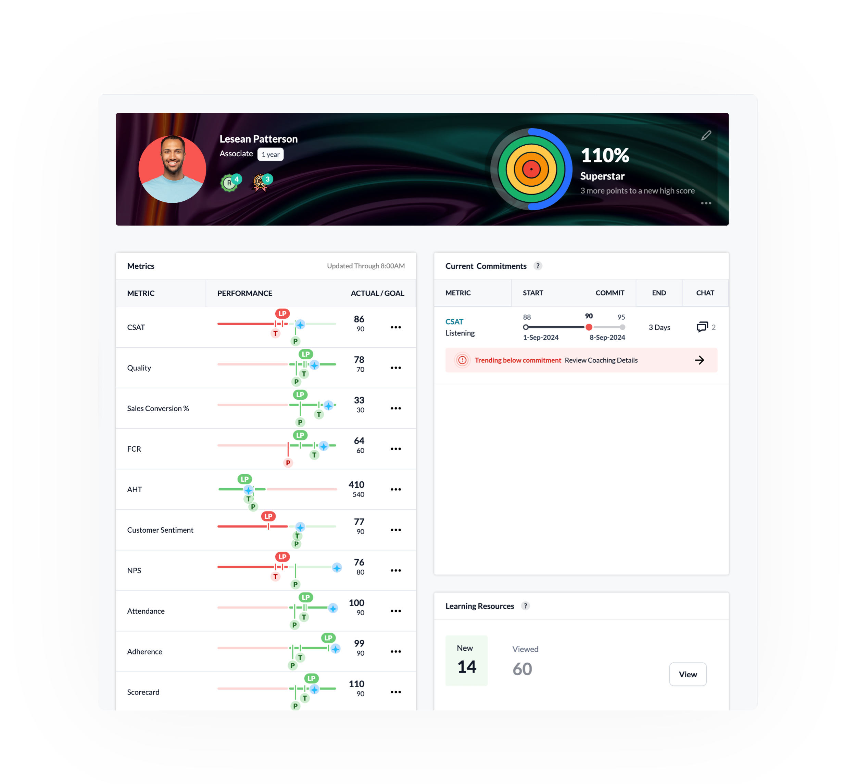
Action your data at the speed of light with:
Provide your teams with the visibility and actions they need to elevate CX - no matter your tech stack. Give every role the right data and actions without burdening IT.
Unified Performance Data. See pre-assembled performance data in one place - every data source is connectable.
Real-Time and Role-Based Views. Access individualized, real-time intelligence for every role - from agents to directors.
High Performer Personas. Digital representations of your A-players establish a universal benchmark of excellence.
Next Best Action. Identify and recommend the most impactful improvement actions for each agent with our AI.
Coaching Effectiveness Scores. Measure the impact of a team leader's coaching on agent performance.
Always Updated and Refreshing. Keep data up-to-date with our patented data ingestion process - always flexible to your needs.

Slide 5
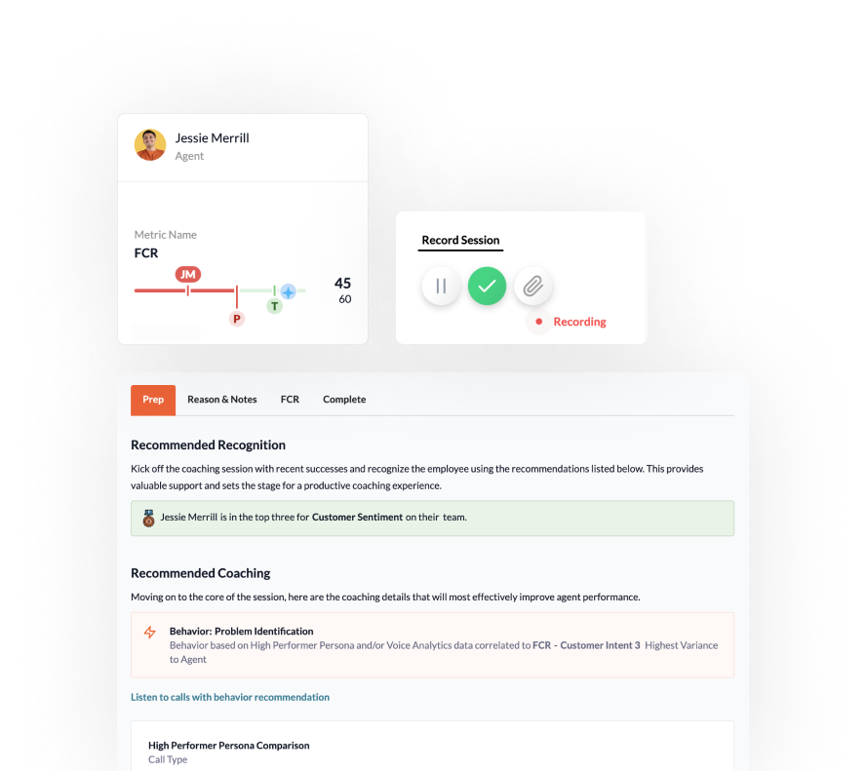
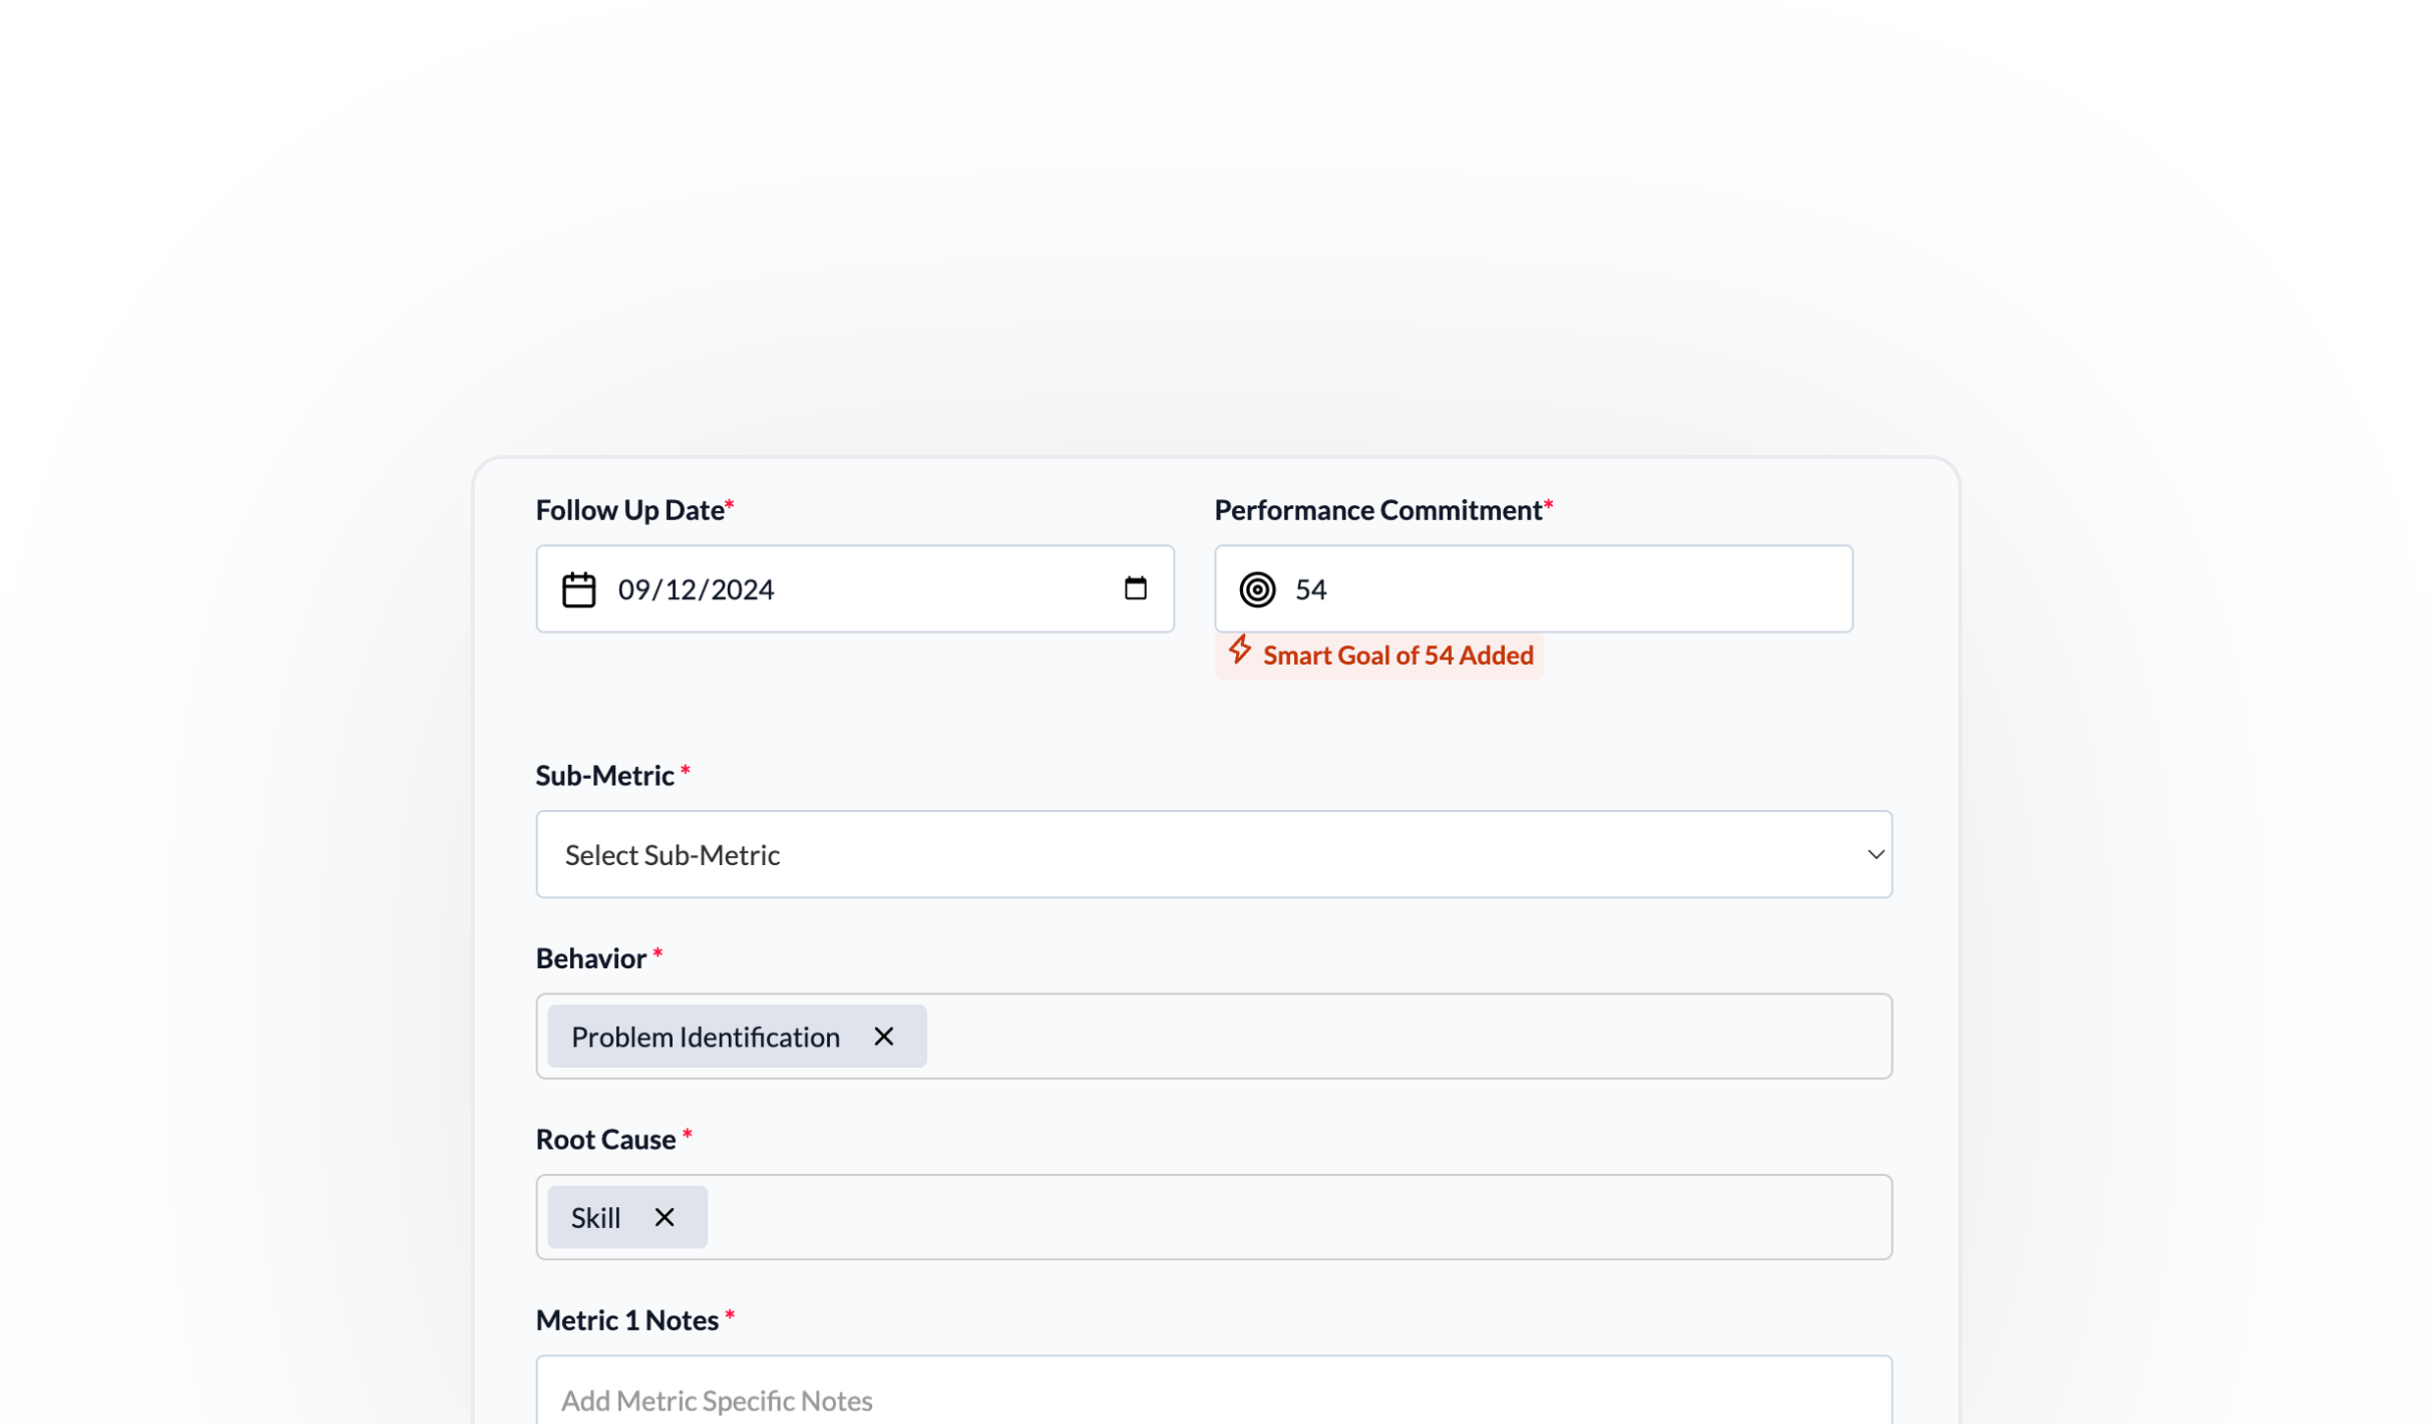
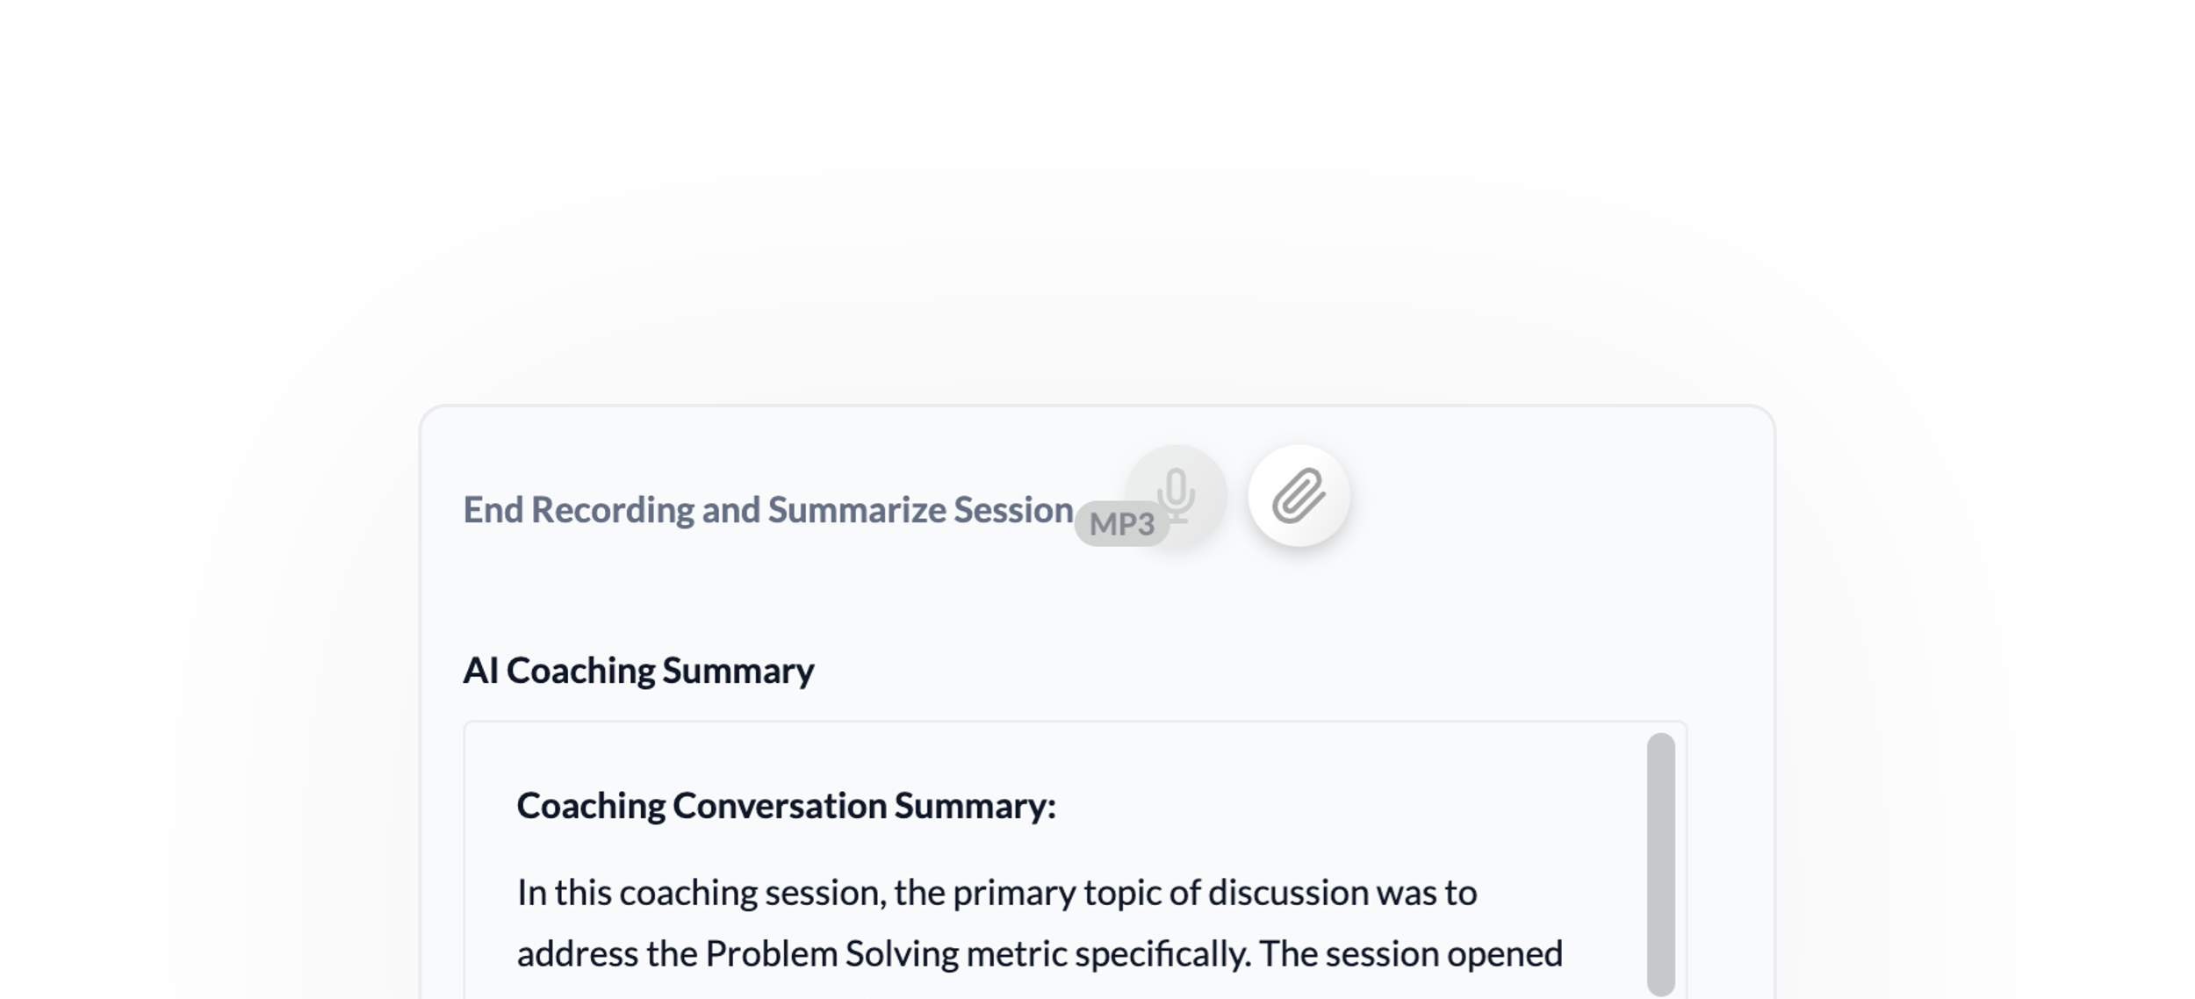
Behind every champion, is an AI-driven coach. Jump into the future of coaching with:
For contact center leaders that want to develop teams into champions, rather than churn through the frontline.
Coaching powered by AI. Delivered by your people.
AI-Driven Coaching Actions. Identify and recommend the most impactful coaching opportunity for each agent with our AI.
Auto Follow up and Recognition. Access individualized, real-time intelligence for every role - from agents to directors.
Coaching Effectiveness Scores. Measure the impact of a team leader's coaching on agent performance.
AI Notes, Audio and History. Generate AI coaching summaries using recorded audio and store for historical coaching.
Custom Coaching Forms. Create a standard template that aligns specific KPIs, behaviors and notes to every interaction.
Smart Coaching Goals. Factor in historical trends and peer performance to every coaching commitment.

Slide 6
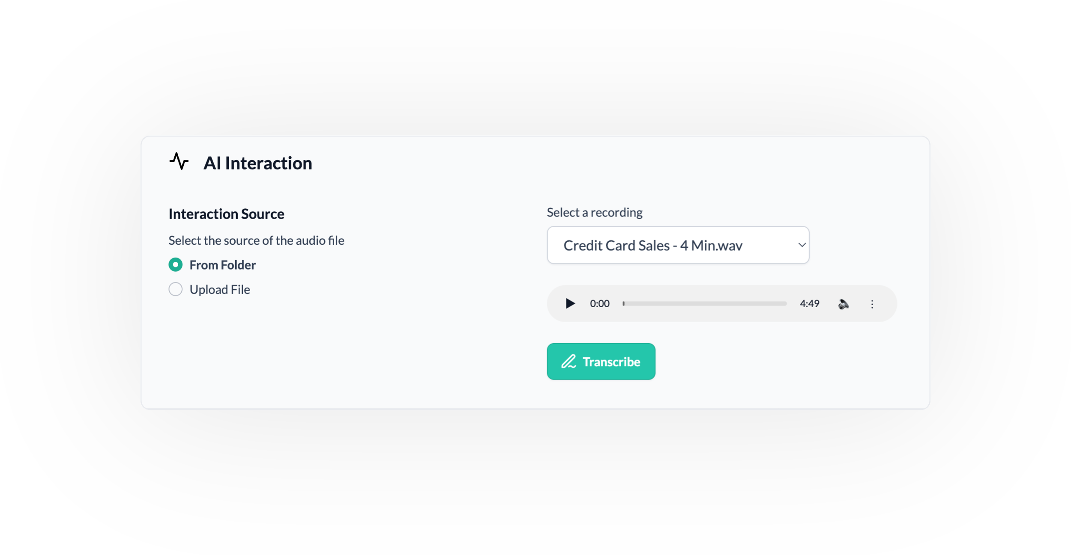
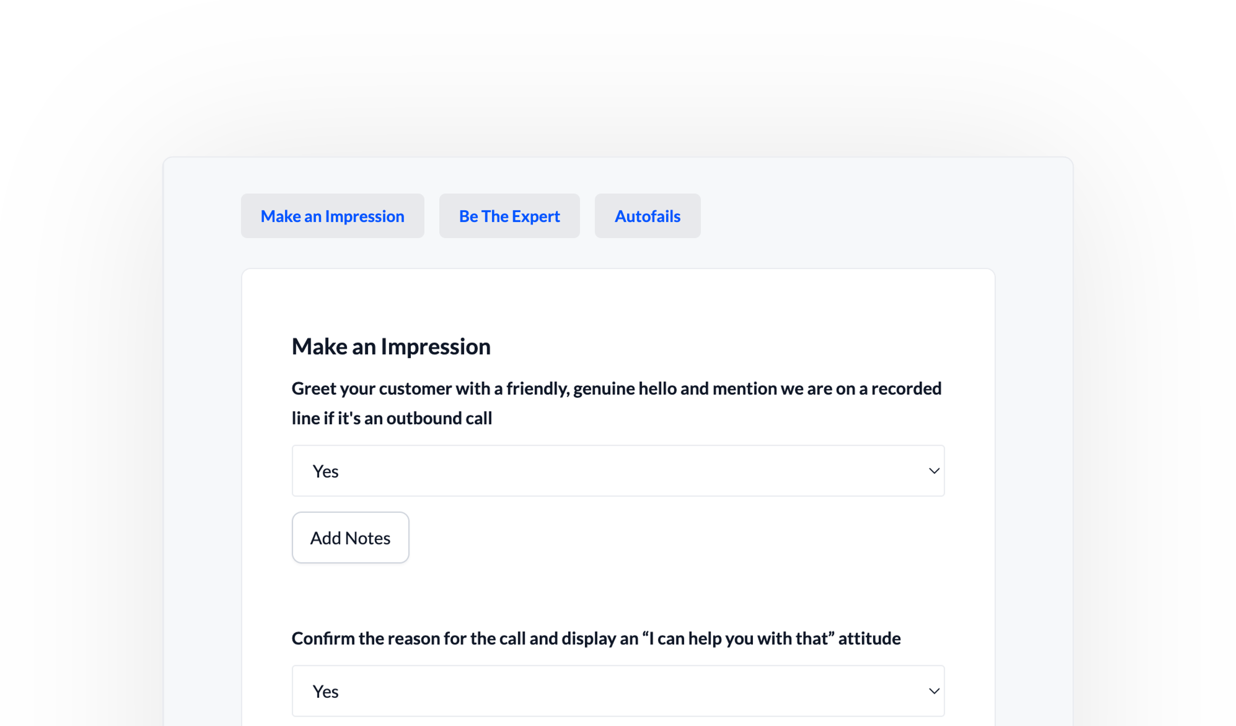
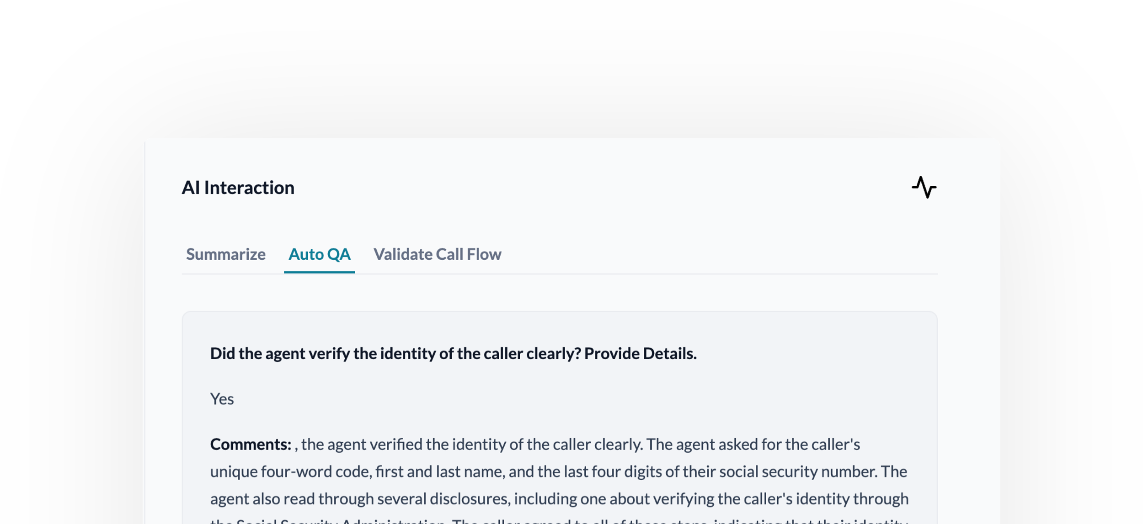
Amplify QA teams efficiency, effectiveness and happiness with:
For contact center leaders that want to transform their QA from Quality Assurance to Quality Acceleration.
Auto QA and Quality Copilot. Supercharge your QA and analyze every customer interaction. Easy interactions are auto-scored and complex ones trigger review.
Quality-Driven Coaching. Create a perfect feedback loop where quality data like auto-fails and low scores fuel targeted coaching for frontline teams.
QA-Driven Recognition. Extend the AI feedback loop to high-scores and wow-interactions with targeted recognition for every praiseworthy achievement.
360-Degree Performance Insights. Connect quality scores, CRM data, call transcripts, and more for a complete picture of what drives contact center success.
Calibration Workflows. Achieve consistency and accuracy in grading, eliminating subjective evaluations and ensuring fair agent feedback.
Customizable QA Reporting. Analyze the quality insights that matter most for your business, by person, by evaluator, by score, by question and more.

Slide 7
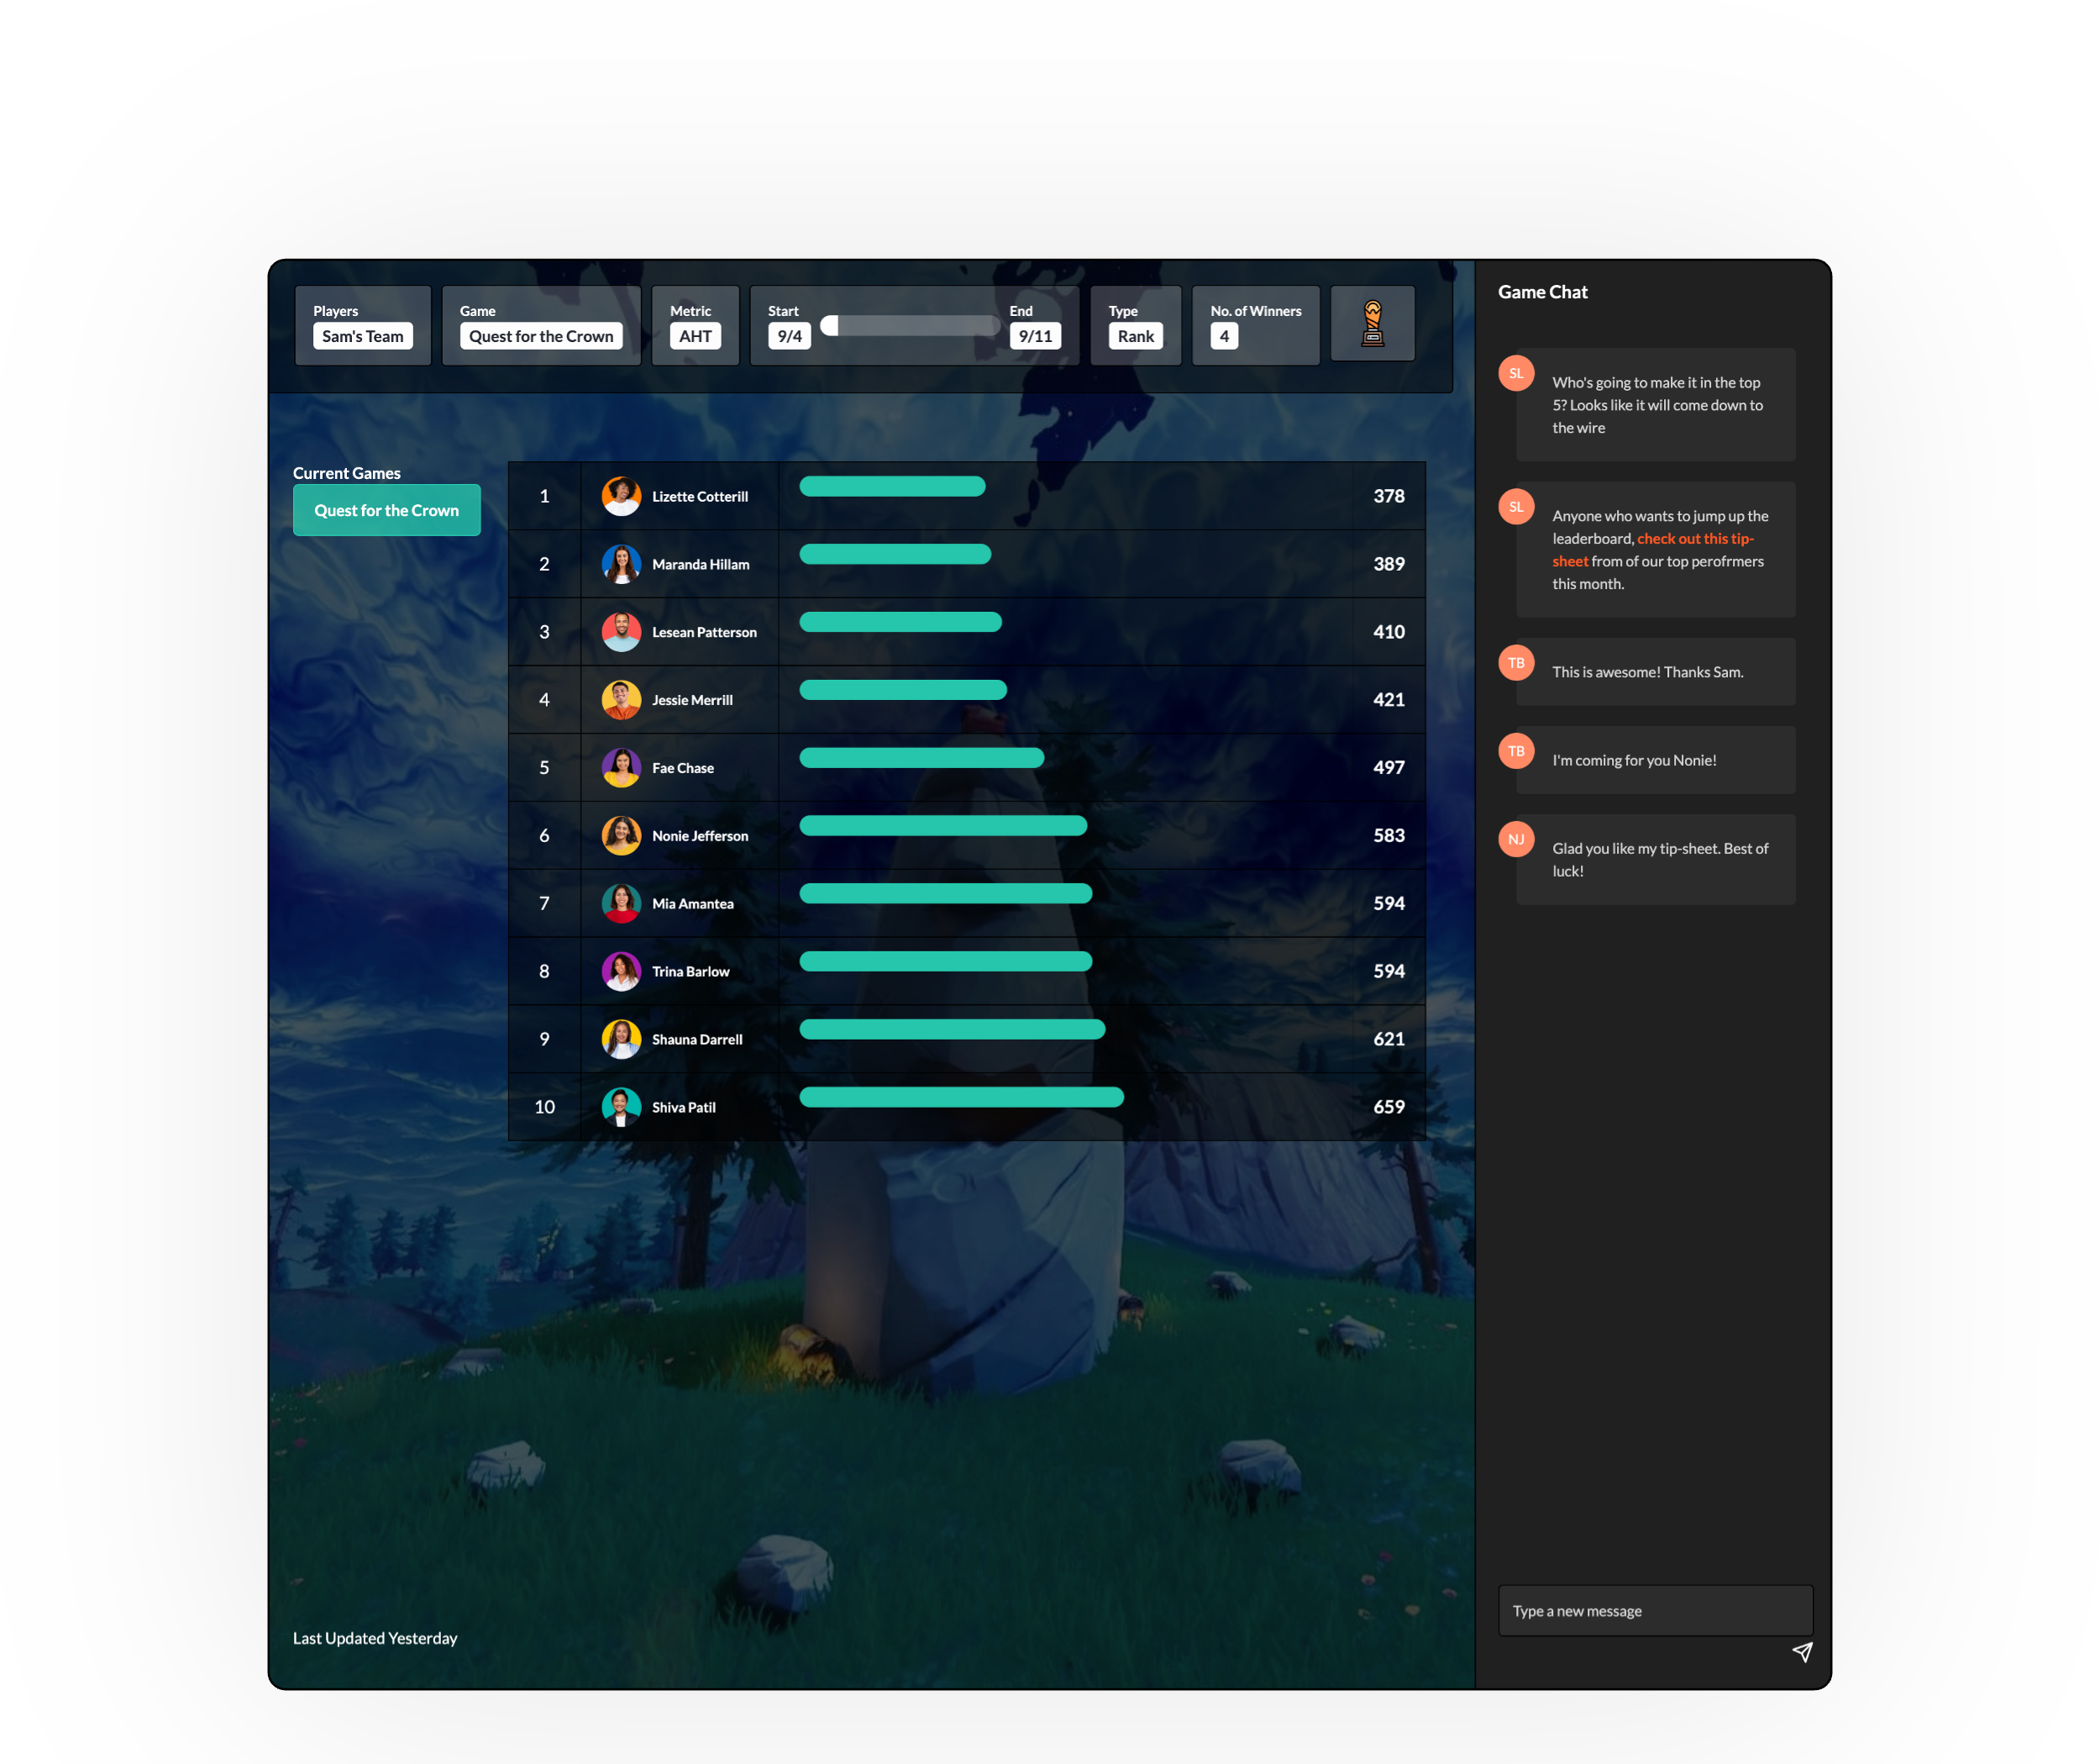
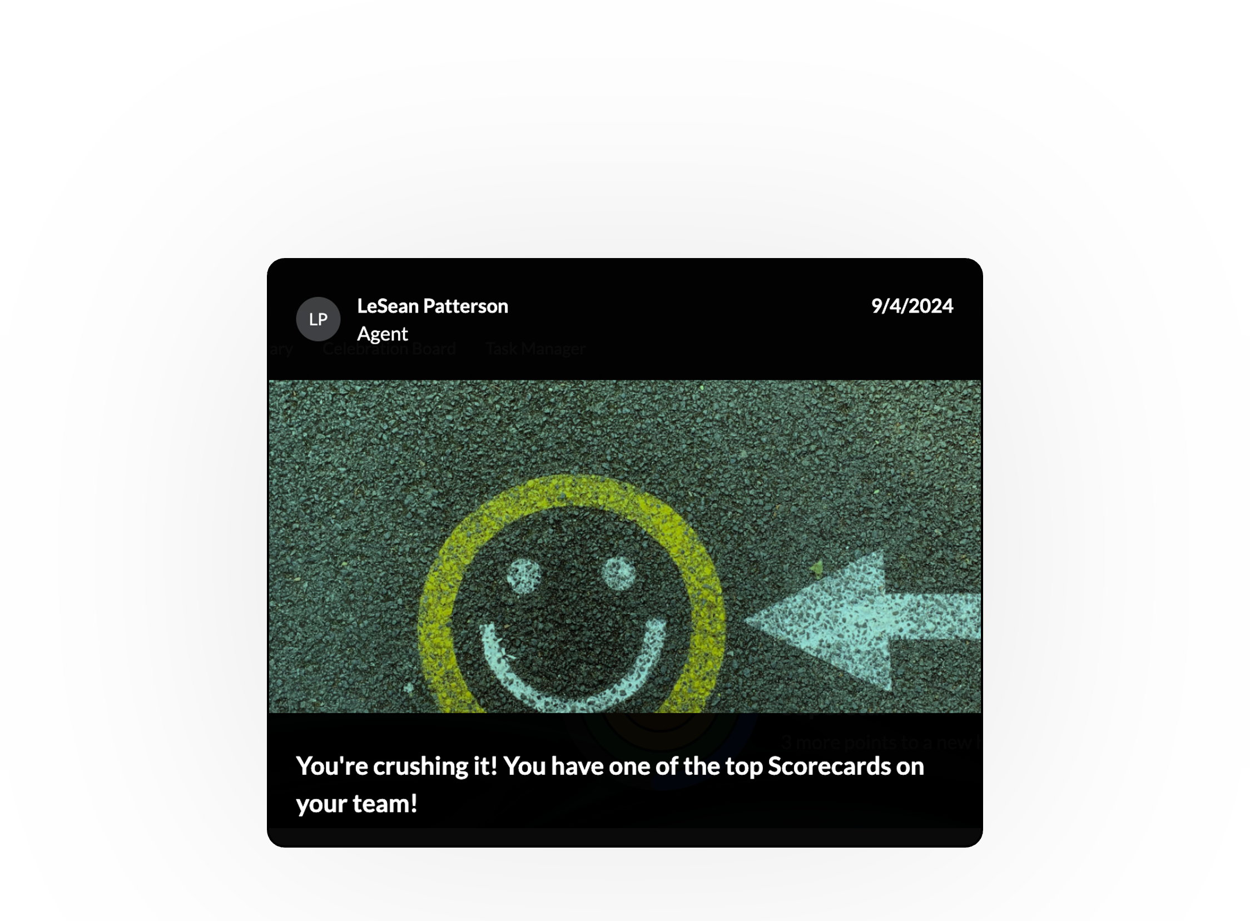
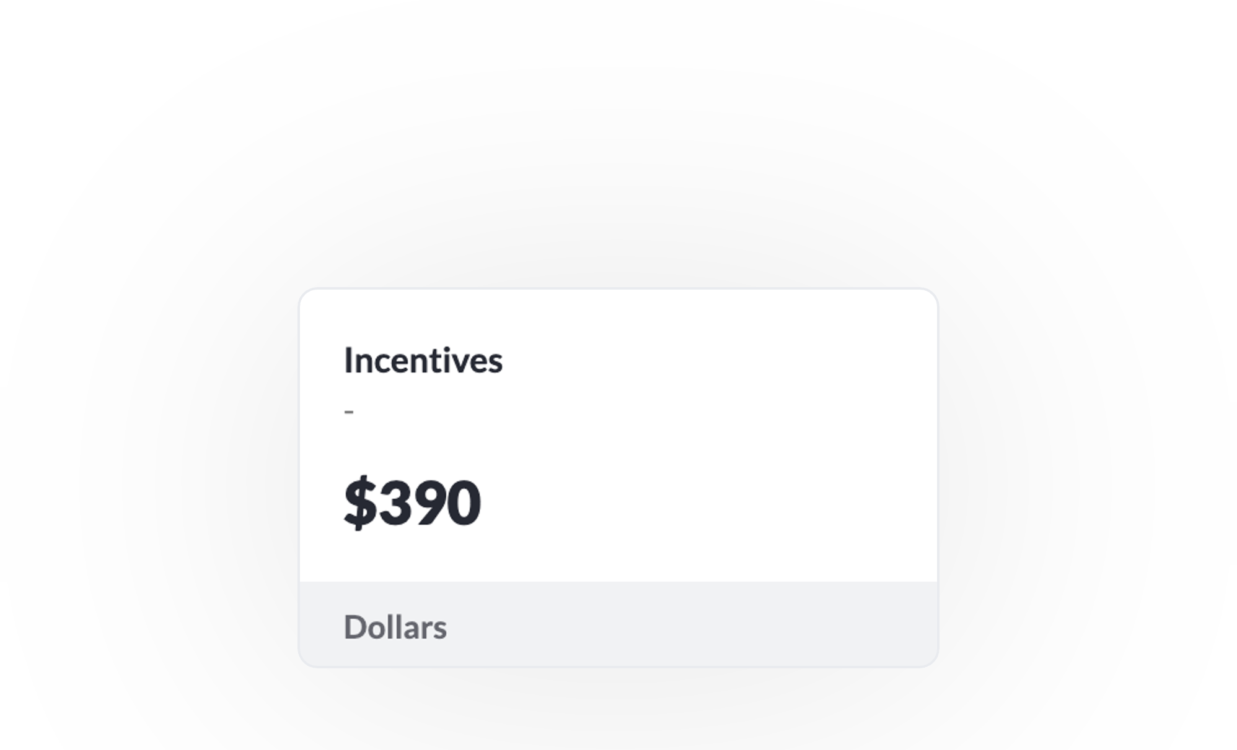
Motivate teams and build a winning culture with:
Smart Recognition. Deliver recognition directly to agents and managers based on recent accomplishments.
Auto Follow up and Recognition. Trigger automatic recognition actions when agents hit coaching commitments.
Social Recognition. Connect teams to a visual tracker showcasing their progress toward the next scorecard level.
Data Powered Games. Ignite intelligent contests that cater to different skill levels, tenure groups or custom conditions.
Real-Time Leaderboards. Track game progress, keeping teams focused and striving for the top.
Incentive Calculators, Badges and so much more. Incentive tracker, calculator, avatars, badges, performance comparisons, scorecard levels, points and rewards...
For contact center leaders who want to get the most juice out of their teams without feeling the squeeze.

Slide 8
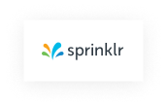
Enjoy effortless data integration with:
Seamlessly connect every data source – from CRMs to Omnichannel to spreadsheets. No data is left behind, powering your contact center with complete, real-time insights.
Agnostic Data Integration. Integration is data independent, enabling complete contact center transformation from all data sources. 150+ cloud API's, SQL and spreadsheets.
Organization and Roster Sync. Your entire organizational hierarchy is mapped and updated. This enables every role to receive the actions and insights needed for their role, those above them, and those below them.
Metric and Behaviors Sync. Mapped metrics and associated behaviors create a unified framework for standardized reporting, granular analysis, and AI-driven action recommendations.
Performance Scorecard. Gain a comprehensive, weighted view of agent and leader performance across your contact center with live scorecards that adapt to your evolving priorities and drive better action.
Initial Implementation. Our professional service teams make it easy to map your organization's needs into the AI-ready platform, with initial implementations ranging from 100s to 10,000s of users.
Continuous Updates and More. This is not a one time lift and shift. Our performance guides maintain active account relationships and ensure your contact center data is always accurate and up-to-date.
CCaaS
CRM
Survey
Quality & WFM
Voice Analytics
Other Sources
150+ connectors unify contact center data within AmplifAI

Slide 9
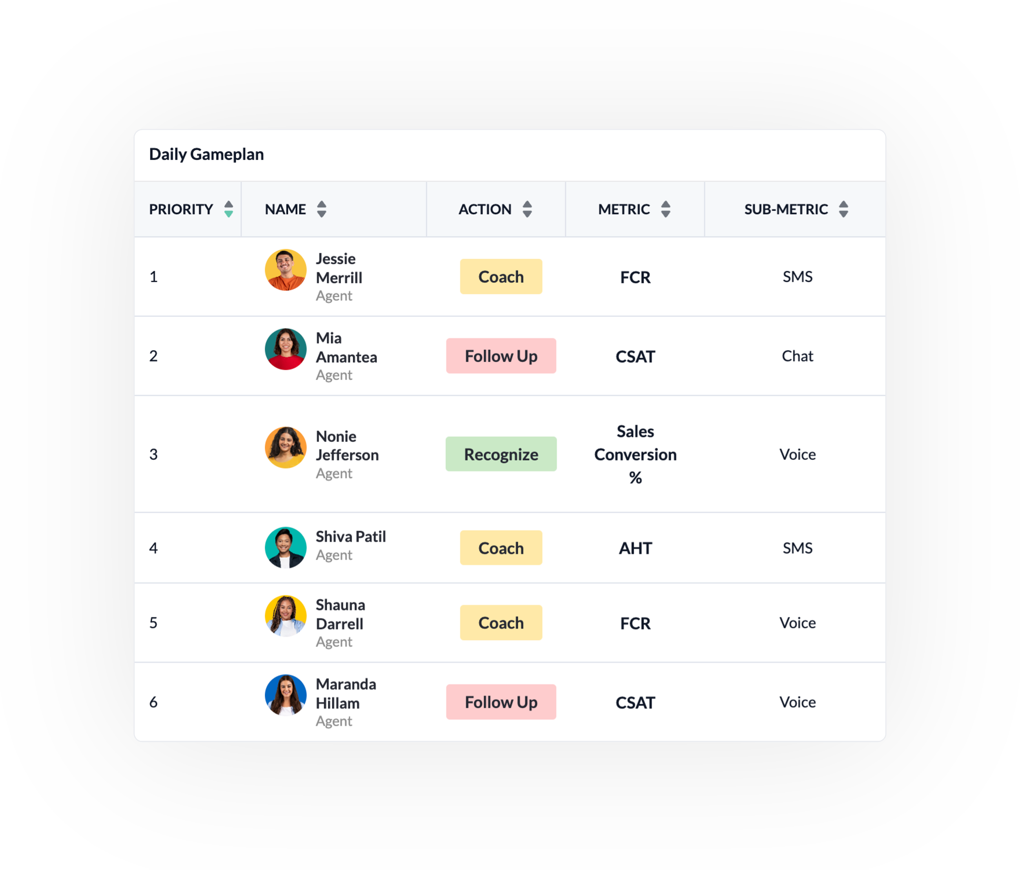
Scale high-performers with:
We prepare the best actions for every role, from agent to director. You reinvest your time maximizing contact center results.
Next Best Action AI. Patented next best action elevates frontline teams by identifying the most effective actions to enhance behaviors, productivity and results.
High Performer Persona Modeling. Create a blueprint for success by modeling the winning behaviors of your top performers, scaling all-star actions company-wide.
Smart Recognition. Craft personalized, results-driven recognition messages tailored to each user, boosting engagement and fostering positivity.
Quality Co-Pilot and Auto QA. Drive a comprehensive quality feedback loop by combining auto QA, quality-driven coaching and QA recognition.
AI Coaching Plans and Summaries. Gain coaching insights with AI-driven game plans and summaries, improving focus, effectiveness, and productivity during 1 on 1's.
AI Training, Predictive Goals & more. Upskill new-hires with simulated customer conversations, help agents hit realistic targets with predictive goals, and much, much more...

Slide 10
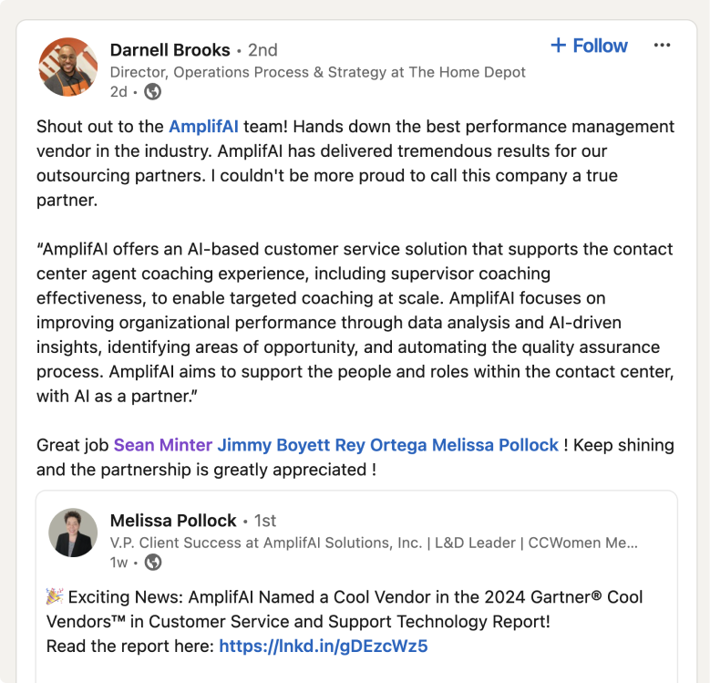
Gartner Cool Vendor
Gartner Cool Hype Cycle Mentions
Customer service and support technology
Vendor in 12 hype cycles reports 2023 - 2024
TM
G2 High Performer
G2 Momentum Leader

Slide 11
Your data's security is our top priority. With AmplifAI, you can have confidence that your information is handled with the utmost care and protected by industry-leading security practices.
AmplifAI is committed to safeguarding your data. Our platform employs stringent security measures and adheres to the highest industry standards to ensure the confidentiality, integrity, and availability of your information.
Multi-layered Protection. AmplifAI utilizes network-level segmentation and region-based data segmentation to provide enhanced protection against unauthorized access.
Compliance & Certifications. We adhere to rigorous industry standards, including GDPR, HIPAA, PCI, ISO and SOC 2, demonstrating our unwavering commitment to data protection and privacy.
Proactive Security. Regular penetration tests, network audits, and security assessments are conducted to identify and address potential vulnerabilities.
Data Governance. We maintain strict data governance policies and procedures to ensure the confidentiality, integrity, and availability of your data.
AmplifAI is actively meeting the stringent security needs of Fortune 500 companies in compliance-driven industries, including finance and healthcare.

Slide 12
Now that you understand the power of AI-driven transformation for your contact center, it's crucial to select the right provider. Some key factors to consider include:
Reach out to see how AmplifAI can help you achieve your contact center goals and exceed the expectations of today's digitally connected customers.
It’s time to rewrite the rules of contact center performance.
Agnostic Integration Capabilities. Can the solution effortlessly ingest data from all your sources, including cloud platforms, homegrown systems, and even flat files? The more comprehensive the data ingestion, the more powerful the transformation insights will be.
Expert Guidance and Ongoing Support. Does the provider have seasoned contact center professionals on their team? Their expertise can guide you through the transformation process and ensure you maximize the value of the AI solution. Avoid vendors who simply offer software without the necessary support and guidance beyond going-live.
Going Beyond Agent-Level Impact. Does the solution focus solely on agent performance, or does it extend its transformative capabilities to other critical roles like team leaders, managers, and trainers? A truly impactful solution will elevate the entire contact center operation.
Comprehensive Solution vs. Point Solution. Does the provider offer a comprehensive suite of AI-powered solutions to address various aspects of contact center operations, or do they focus on a single capability like gamification or reporting? To fully utilize the efficiency and effectiveness of all contact center roles, a comprehensive solution set is often necessary.
Book a call
TM

Slide 13
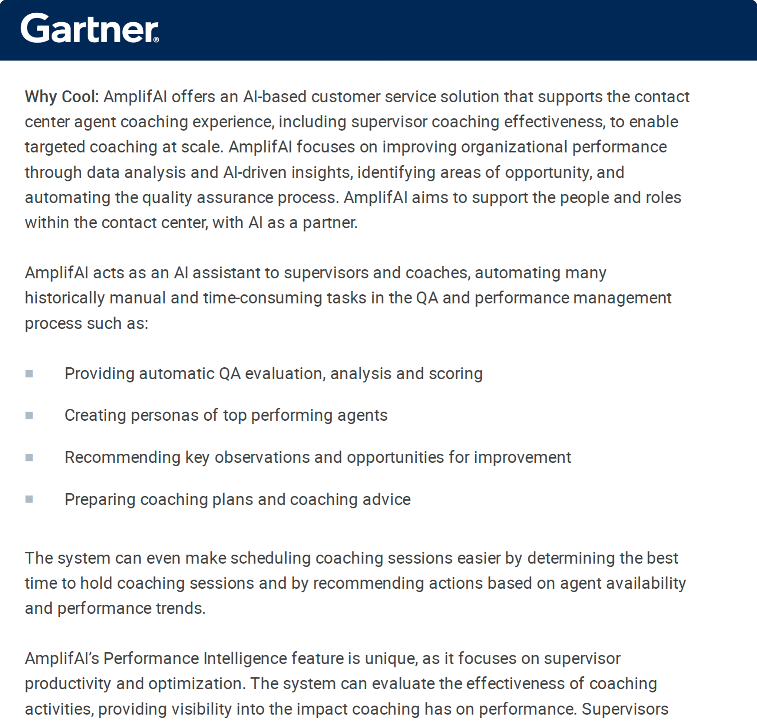
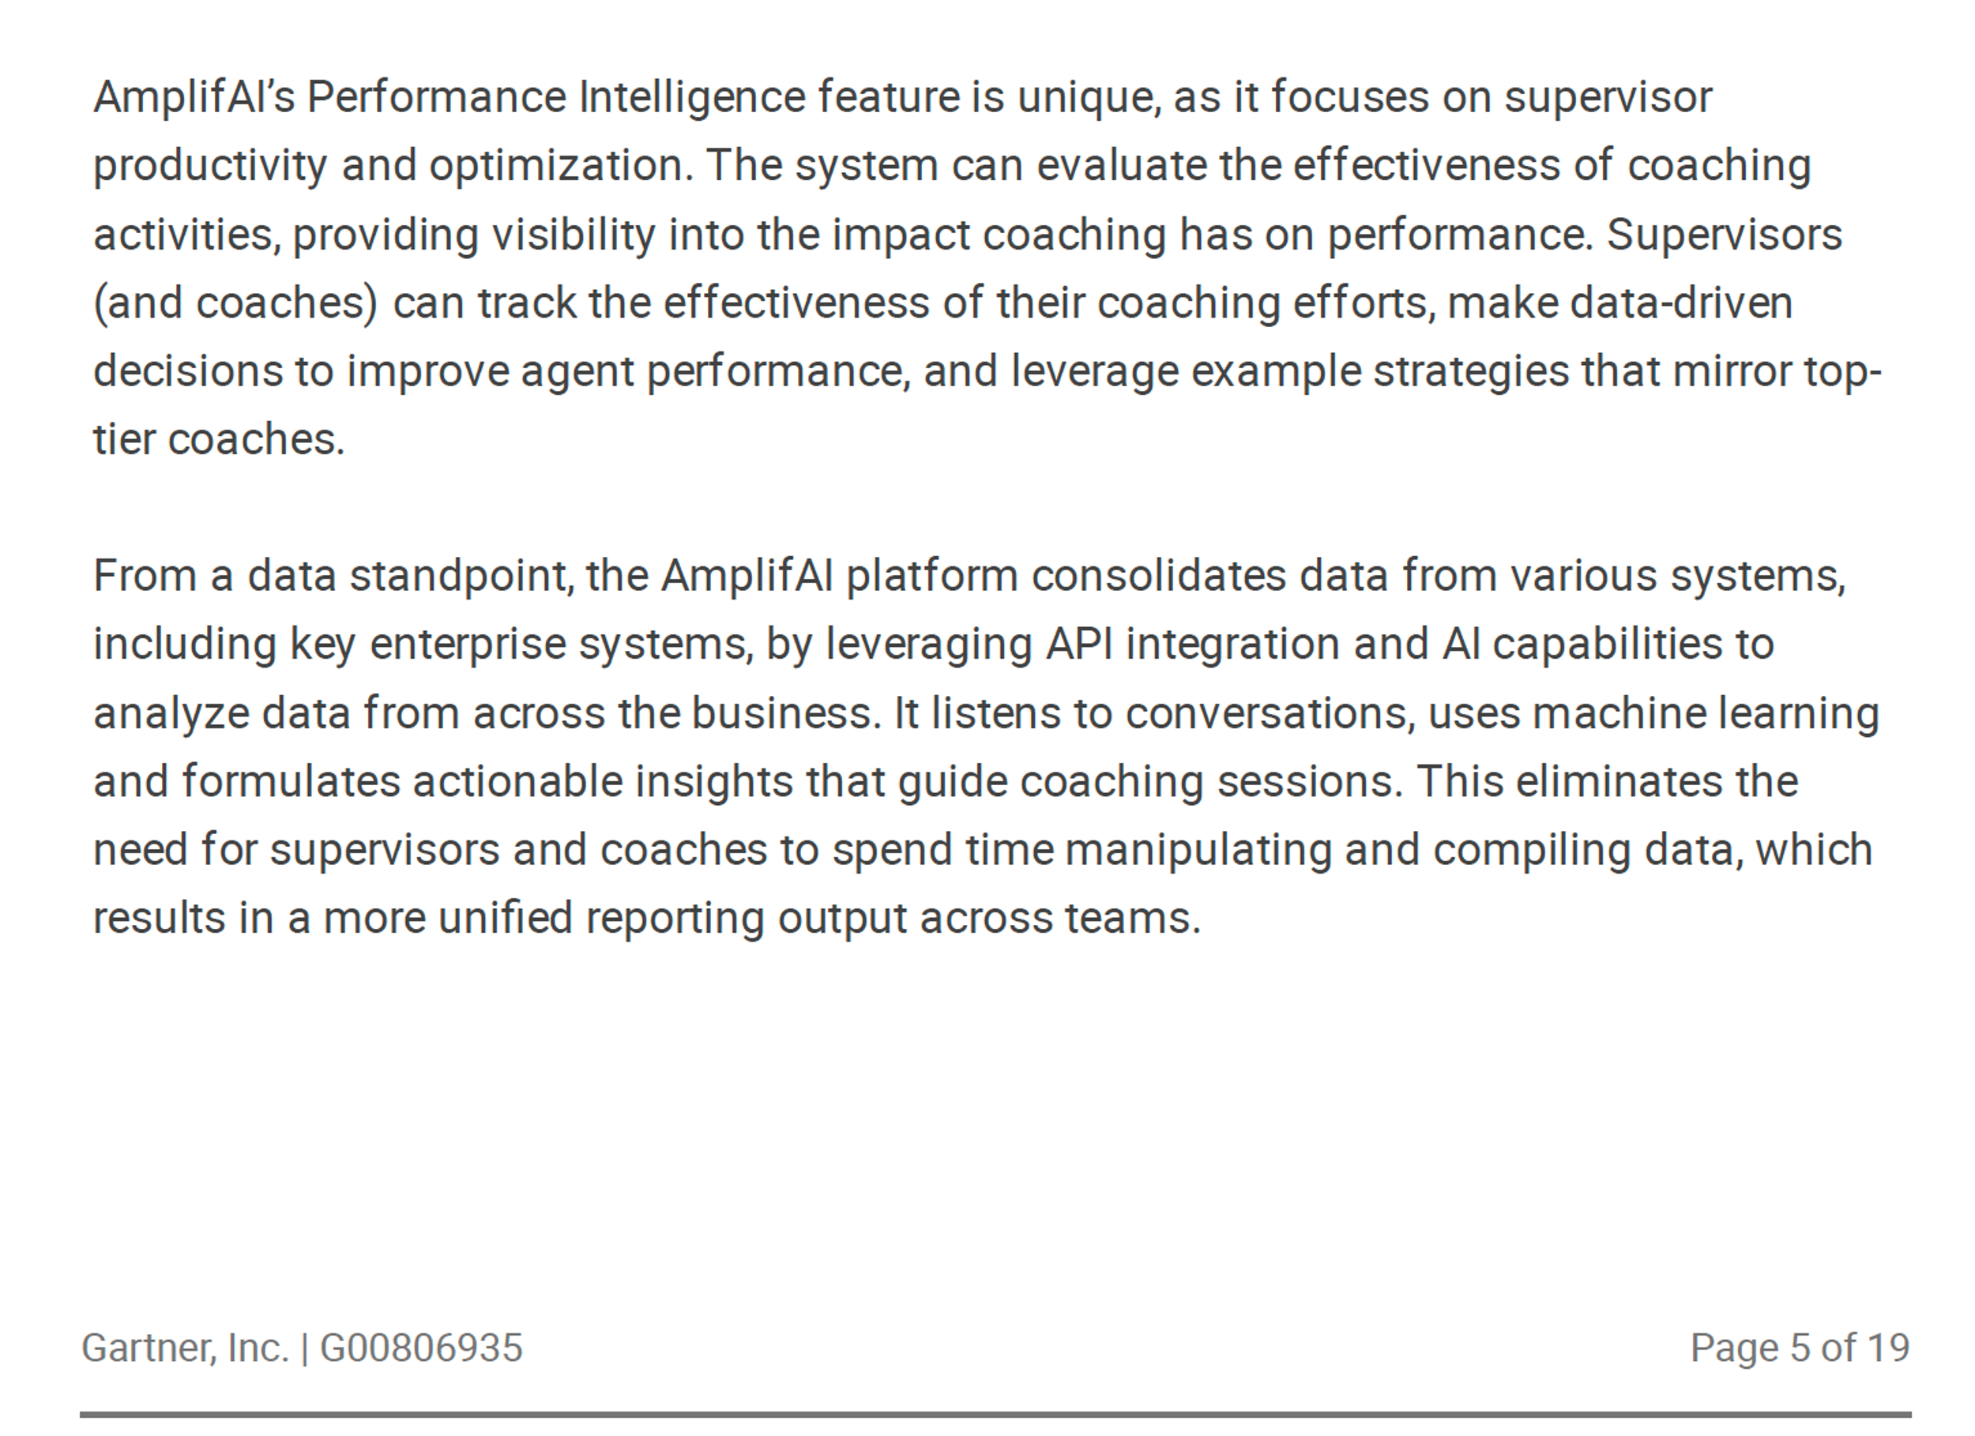
TM
Read The Full Cool Vendor Report

